Slide 1
Team details
Idea Presentation For Smart India Hackathon Grand Finale 2022
Problem statement/current issues Work-flow diagram
Use case diagram Proposed solution

Slide 2

Details of the team and problem statement
Ministry : Ministry of rural development
PS code : SH1007
Problem statement title : Mechanism to help rural people to self select for receiving benefit offered underGovt. scheme.
Team name : Vision
Team leader name : Abhishek Singh
Institute code [AISHE] : U-0502
Institute name : Institute of engineering and technology Bundelkhand University Jhansi
Theme name : Agriculture, foodtech & rural development

Slide 3


Problem statement description [SH1007]
In the existing scenario, the approach followed for beneficiary selection for various schemes is top-down. All rural development programs/schemes aim at extending maximum benefits to the rural poor. Assessment of eligibility is done by various officials assigned at Centre/States etc. A system is needed where the beneficiary can get selected into schemes and offer himself to be tracked using a unique identifier.
Sample Data Required: Yes
Existing Issues
There is no platform where users can get customized scheme suggestions and tracker system.
Only provide a list of various live schemes under center, state category, no personalization on the basis of user details.
Updation of scheme-related information is not done on a regular basis.

Slide 4
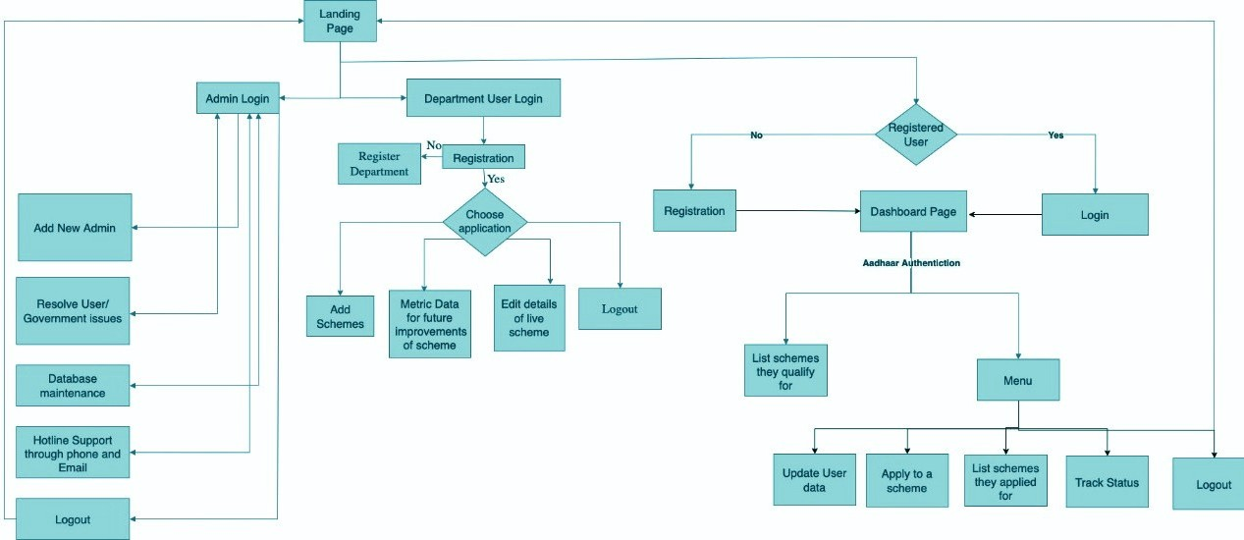

Work- flow Diagram

Slide 5

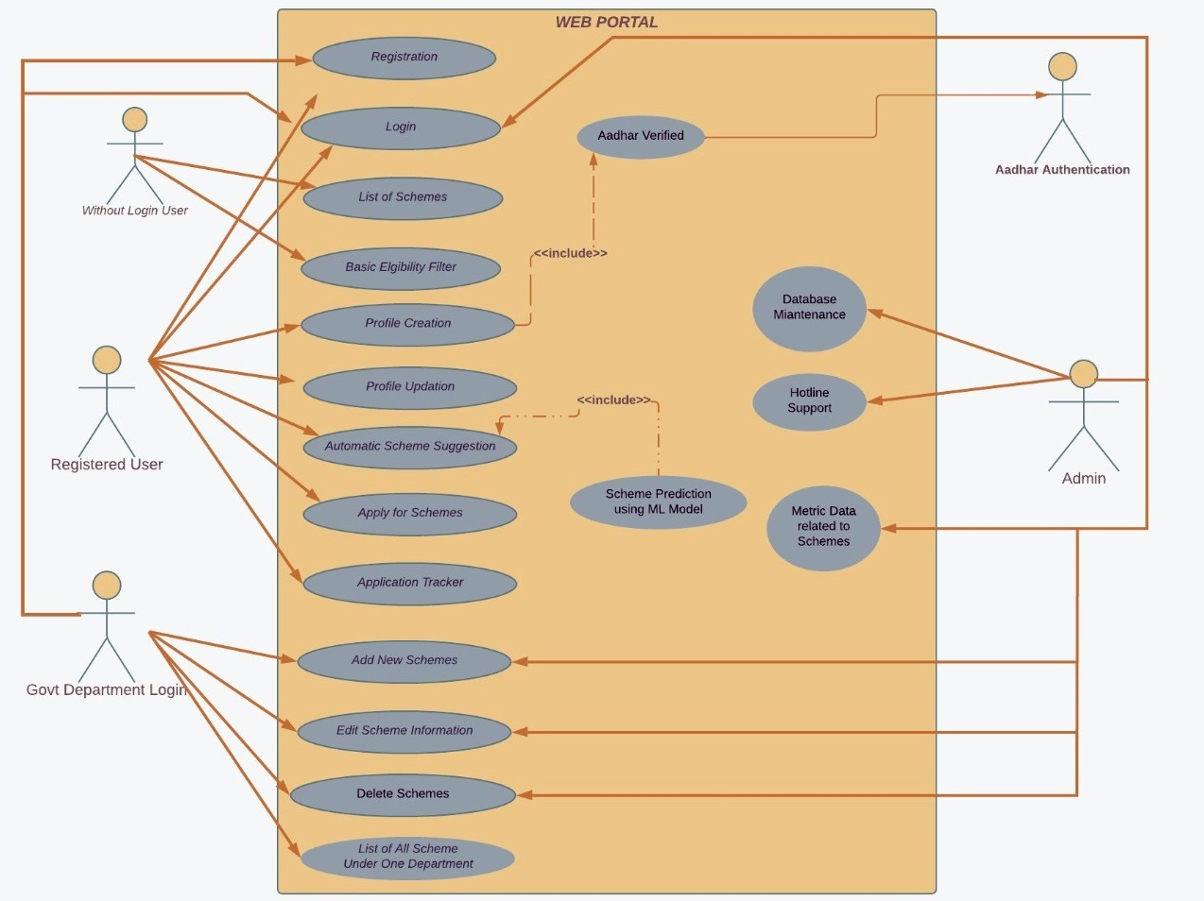
Use-case
diagram

Slide 6







Proposed Solution
Feature 1
Customized schemes suggestion using user data and machine learning models.
Feature 4
Feature 2
Aadhaar Authentication
Single platform for scheme suggestion and for tracking the status of the scheme in which they have applied.
Feature 5
Feature 3
ML model predicting schemes using two models-
One, on the basis of common parameters
Second, using demographic location
Send updates about upcoming schemes and the last date of various schemes for which the user is eligible.

Slide 7
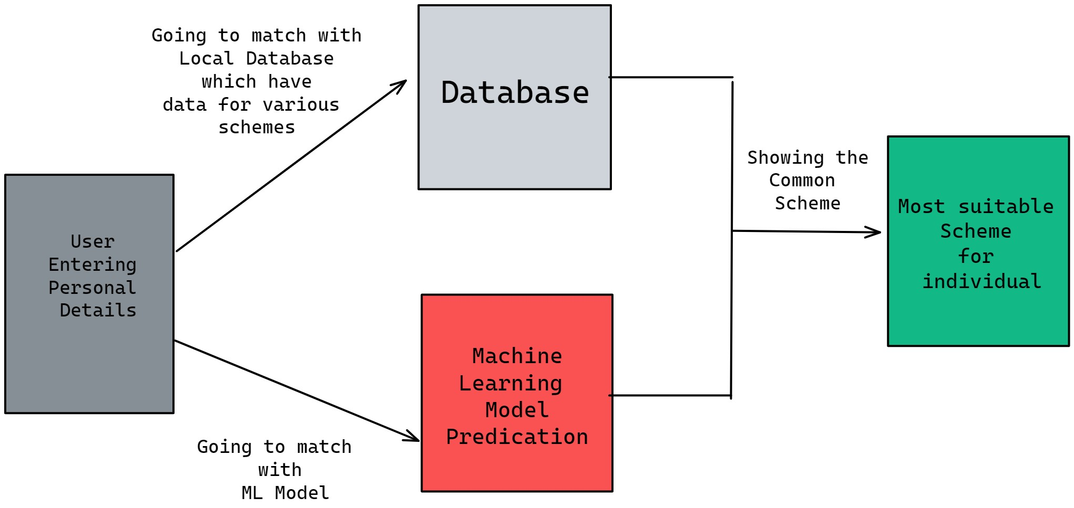
How we are predicting Schemes

Slide 8
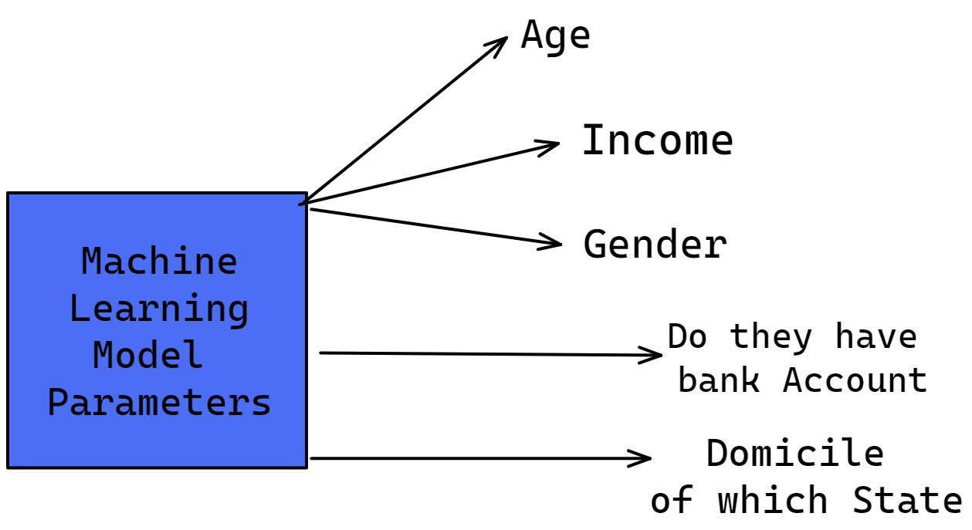
Parameters for ML Model

Slide 9
User Registration
Process

Slide 10
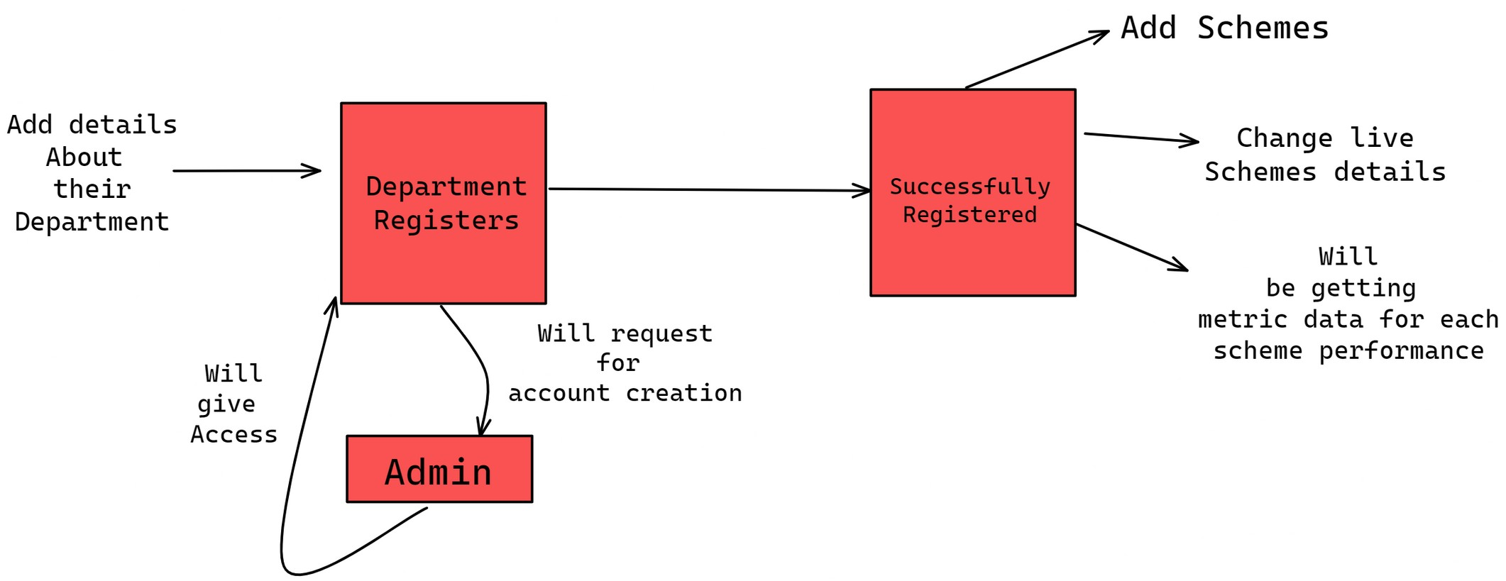
Department Registration Process

Slide 11
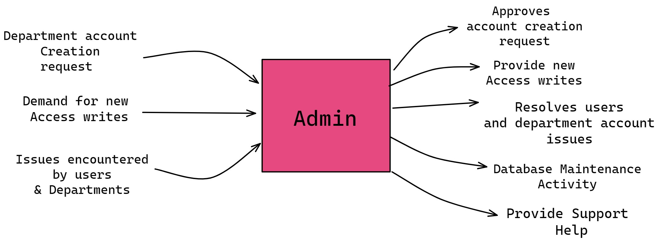
Admin Role

Slide 12
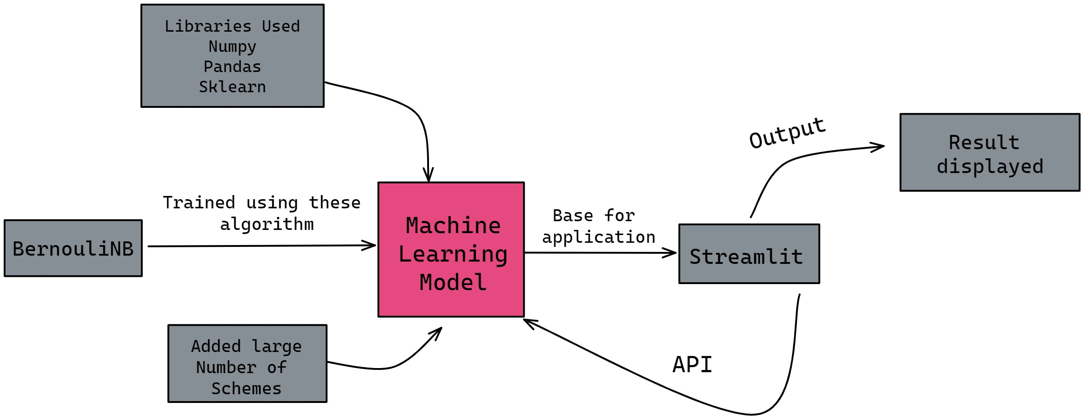
ML Model Work Flow

Slide 13

Thank you
End

